Slide 1
Unit testing

Slide 2
Check out the test
How to pass in the data?
A model to the constructor
Parameters on the HTTP Request
A model in the context

Slide 3
Convenience methods
ModelUtilitiesTestHelper
Creating the model:
model()
typeStatement()
objectProperty()
dataProperty()
(and more)
Testing the result:
SortedSet<String> modelToStrings()

Slide 4
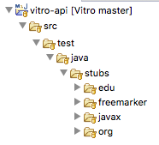
Stub classes
Located in stubs plus the.original.package

Slide 5
Stub classes
Some examples
HttpServletRequestStub
SearchEngineStub
IndividualDaoStub
ConfigurationPropertiesStub
I18nStub
Not a stub, but a very useful adapter:
RDFServiceModel

Slide 6
Inherited methods
From AbstractTestClass
Some samples:
Control and/or capture log output, stdout, and stderr
Set Java system properties
Manage temporary files
Describe expected exceptions
Compare XML documents

